Slide 1
Image Segmentation
Part – 1
Segmentation based on Thresholding

Slide 2
Content
Segmentation Basics
Various Segmentation Techniques
–Thresholding based
–Region-based
Region growing
Region Split and merge
Watershed Algorithm: Segmentation by morphological watershed

Slide 3
Segmentation Basics
Image segmentation deals with image partitioning
process of partitioning a digital image into multiple homogeneous segments
Simplification of representation
Simplification of the representation of an image into something which is more meaningful and easier to analyze
It is used to locate objects and boundaries

Slide 4
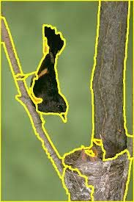
Segmentation Basics
Segmentation Example
Yellow lines show the segmentation boundaries

Slide 5
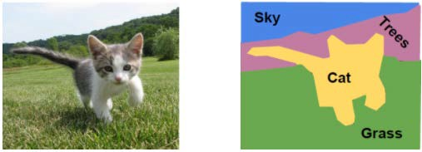
Segmentation Basics
Pixels labeling:
It is the process of assigning a label to every pixel in an image
All pixels with same label share certain visual characteristics
Input image
Expected Segmentation output
Image source: https://www.mygreatlearning.com/blog/fcn-fully-convolutional-network-semantic-segmentation/

Slide 6
Segmentation Techniques
Similarity-based methods:
partition an image regions that are similar according to a set of predefined criteria
Examples: methods based on
thresholding
region growing
region splitting and merging
Discontinuity-based methods:
Use of point, line and edge for segmentation

Slide 7
Segmentation Basics
Similarity Criterion
It can be defined with respect to some characteristic or computed property
Common Characteristics/Properties
Color
Intensity
Texture
Adjacent regions are significantly different with respect to the same characteristic(s)

Slide 8
Similarity-based Methods
Thresholding
Region growing
Region splitting and merging

Slide 9
Thresholding Techniques
Global thresholding
Adaptive thresholding
Optimal global and adaptive thresholding

Slide 10
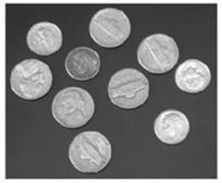
Basic Global Thresholding
When same threshold is applied over entire image, the thresholding is referred as Global Thresholding
Example:
An image where foreground objects (coins) can be segmented from black background using only one threshold

Slide 11
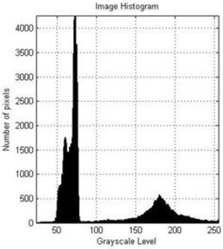
Basic Global Thresholding
Histogram based
Threshold Selection
Two clear peaks in the histogram
One for foreground and another for background
A suitable threshold can be chosen to do segment foreground (object) from background

Slide 12

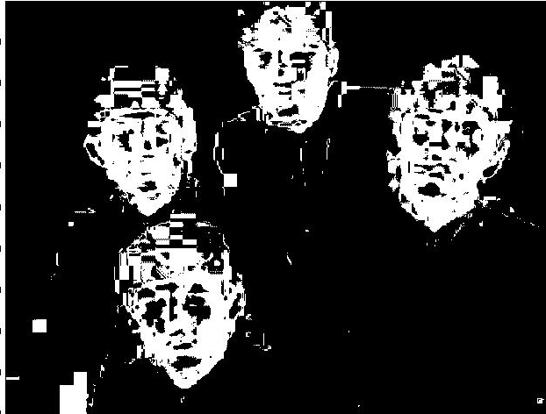
Basic Global Thresholding
Thresholding: color-based
Example: color-based segmentation
fg_pixel = find(Hue > t1 & Hue < t2);
Looking for pixels within a certain hue range in HSV (hue, saturation, and value) color space.

Slide 13
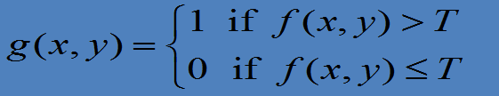
Basic Global Thresholding
Thresholding can be viewed as
T=T[(x,y), f(x,y), p(x,y)]
where
f(x,y) is a gray-level defined at point (x,y) and
p(x,y) is a local property defined at point (x,y)
A thresholded image g(x,y) is defined as follows
f(x,y) is input image and
g(x,y) is the segmented image

Slide 14
Basic Global Thresholding
Different cases of thresholdings
General expression of thresholding
T=T[(x,y), p(x,y), f(x,y)],
When T=T [ f(x, y)] threshold is global
When T=T [(x, y), f(x, y)] threshold is local
When T=T [(x, y), p(x, y), f(x, y)] threshold is dynamic or adaptive

Slide 15
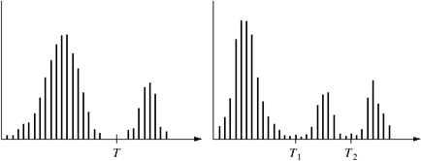


Basic Global Thresholding
Single threshold sufficient
Multiple thresholds required
(a)
(b)
Grey-level histograms that can be partitioned by
(a) a single threshold
(b) multiple thresholds

Slide 16
Basic Global Thresholding
Requirement of multiple thresholds?
– In general, segmentation problems requiring multiple thresholds are
region growing
best solved using methods (discussed later)

Slide 17
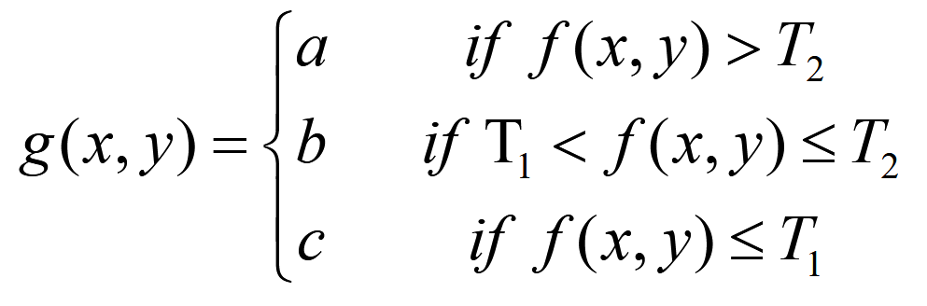
Basic Global Thresholding
Segmentation in case of Multiple Thresholds
where a, b, c are any three distinct values used as labels to show segmentation

Slide 18
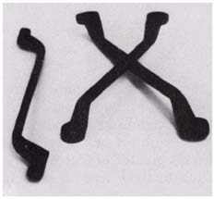

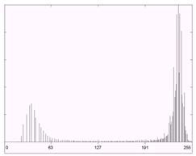
Basic Global Thresholding
Success of thresholding methods
– entirely depends on
how well the histogram can be partitioned
Following is an example of ‘clean’ segmentation.
Result of global thresholding with T midway between the max and min gray levels
Original Image
Image Histogram

Slide 19

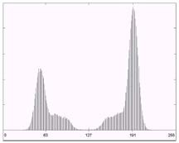

Example: Fingerprint Image Separation
Original Image
Image Histogram
Result of segmentation with the threshold estimated by iteration (see next slide)

Slide 20
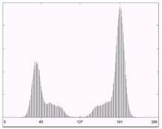
Automatic Generation of Global Threshold
Select an initial estimate for T
Segment the image using T
This will produce two groups of pixels: G₁ consisting of all pixels with gray level value > T and G₂ with values ≤ T
Compute the average gray level values μ₁ and μ₂ for the pixels in region G₁ and G₂
Compute a new threshold value: T = 0.5(μ₁ + μ₂ )
Repeat the Steps 2 through 4 until the difference in T in successive iterations is smaller than a predefined parameter T₀

Slide 21
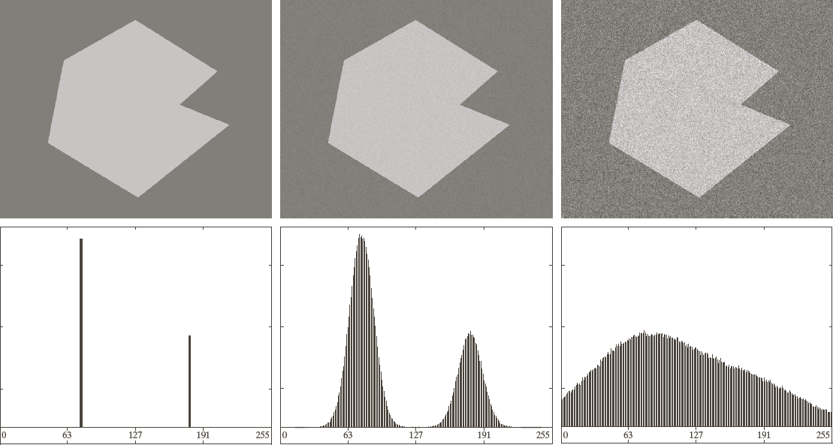

Role of Noise in Thresholding
(a) Noiseless 8-bit image, (b) Image with additive Gaussian noise with mean=0, S.D.=10 intensity levels, (c) Image with additive Gaussian noise with mean=0, S.D.=50 intensity levels, (d)-(f) Corresponding Histograms

Slide 22
Role of Noise in Thresholding
When there is no noise:
Segmentation is a trivial task as histogram consists of two spikes
Threshold can be placed anywhere between two modes
Addition of Noise:
Mean=0, SD=10:
Histograms modes are now broader, however, their separation is large enough so that the depth of the valley between them is sufficient to make the modes easy to separate.
Threshold placed midway between the two peaks would do nice job
– Mean=0, SD=50:
There is no way to differentiate between two modes

Slide 23
Role of Illumination in Thresholding
Simple Image Formation Model of an image f(x, y) can be seen as product of following
illumination component i(x, y), i(x,y) ∈ [0,∞]
Amount of illumination incident on the scene viewed
reflectance component r(x, y), r(x,y) ∈ [0,1]
Amount of illumination reflected by the objects in the scene
f (x, y) = i(x, y)r(x, y)
z(x, y) = ln f (x, y)
= ln i(x, y) + ln r(x, y)
= i' (x, y) + r' (x, y)

Slide 24
Role of Illumination in Thresholding
In general, when only the reflectance component is present (and illumination is uniform), the modes in the histogram can be more easily separated
Note that reflectance is usually not uniform as it depends on the characteristics of the imaged objects
However, illumination can be made uniform as it is characteristics of the light source
When the varying illumination component is present separation of histograms peaks becomes much more difficult

Slide 25
Role of Illumination
From probability theory:
– If two random variables are independent, the histogram of their sum is the convolution of respective histograms
This process would make illumination component smear the histogram of reflective component

Slide 26
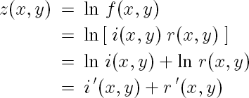
Role of Illumination
Explanation
Since i’ is independent of r’, we know from probability theory that
Note that when Then

Slide 27
Role of Illumination
Then
So that
🡪 Therefore, when the illumination is uniform, the histogram is not substantially affected
With non-uniform illumination though
which results in hist(z) being smoothed or smeared

Slide 29
Image Segmentation
Part – 2
Adaptive Thresholding

Slide 30
Content
Various Segmentation Techniques
–Thresholding based segmentation
–Region-based
Region growing
Region Split and merge
Watershed Algorithm: Segmentation by morphological watershed

Slide 31
Thresholding Techniques
Global thresholding
Adaptive thresholding
Optimal global and adaptive thresholding

Slide 32
Basic Global Thresholding
Different cases of thresholdings
– General expression of thresholding
T=T[(x,y), p(x,y), f(x,y)]
When T=T [ f(x, y)] threshold is global
When T=T [(x, y), f(x, y)] threshold is local
When T=T [(x, y), p(x, y), f(x, y)] threshold is dynamic or adaptive

Slide 33
Example: Global Thresholding
Fingerprint Image Segmentation
Original Image
Image Histogram
Result of segmentation with the threshold estimated by iteration (see next slide)

Slide 34
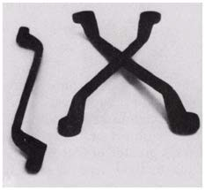
Application of Global Thresholding
Global thresholding works well in controlled environments
Examples
Fingerprint segmentation
Industrial applications

Slide 35
Limitation of Global Thresholding
Global thresholding works only in highly controlled environments
Example:
– applications such industrial inspection, where control of the illumination usually is feasible

Slide 36
Limitation of Global Thresholding
Noise and uneven illumination degrades the performance of global thresholding

Slide 37


Adaptive Thresholding
As illustrated:
imaging factors such as uneven illumination can transform a perfectly segmentable histogram into histogram that can’t be partitioned effectively by a single global threshold
An approach for handling such a situation is as follows
to divide the original image into sub-images and
utilize a different threshold to segment each image

Slide 38

Adaptive Thresholding
Adaptive with respect to pixel location
–Since the threshold is related to the location of pixel, this type of thresholding is usually referred as adaptive
Two key issues:
–How to perform subdivision
–How to estimate local threshold

Slide 39



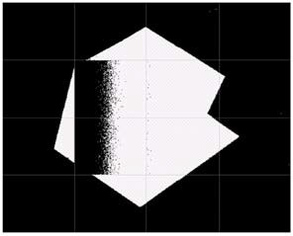
Illustrative example
Original Image
Result of global thresholding
Image subdivided into individual sub-images
Result of adaptive thresholding

Slide 40
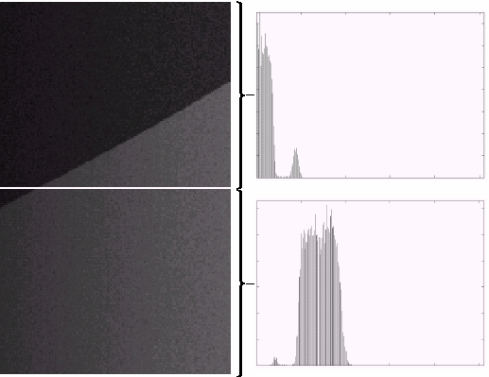


Illustrative Example
Good segmentation
Bad segmentation
How to solve this problem?

Slide 41




Illustrative Example
How to solve this problem?
Answer: further subdivision
What should be the depth of sub-division?
This depends on application/problem

Slide 42
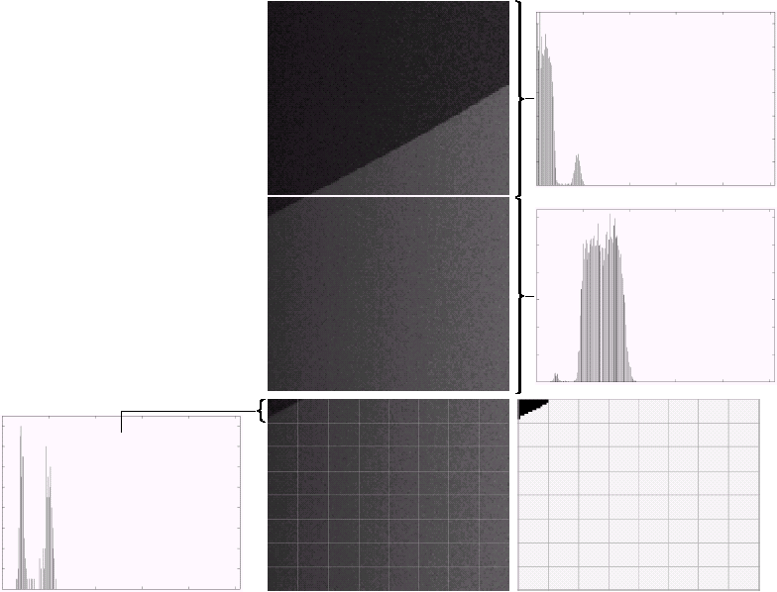
Input Image
a |  | b
 |  | c
e | d | f
(a) Properly and improperly segmented sub-images from the input image, (b)-(c) Corresponding histograms
Further sub-division of the improperly segmented sub-image
Histogram of small sub-image ,
Result of adaptively segmenting (d)

Slide 43



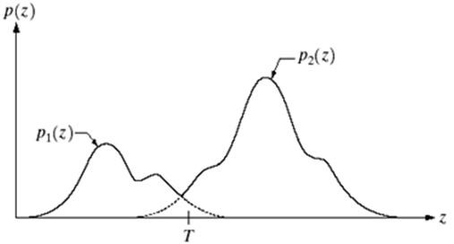
Optimal Global and Adaptive Thresholding
Optimality criterion is:
– minimum average segmentation error
Suppose that an image contains only two principal gray-level regions, and random quantities z denote gray-level values
Gray-level probability density functions of two regions in an image

Slide 44
Optimal Global and Adaptive Thresholding
So, the overall gray-level variation in the image is:
p(z) = P₁ p₁ (z) + P₂ p₂ (z)
and P₁ + P₂ = 1
where P₁ and P₂ are the probability of occurrence of object and background pixels

Slide 45
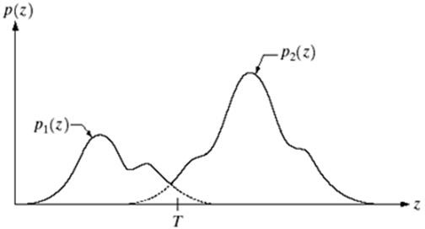
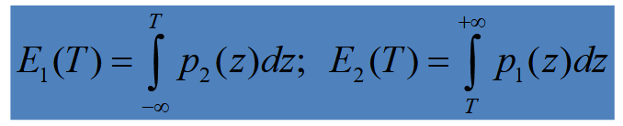
Optimal Global and Adaptive Thresholding
Objective:
– select the value of T that minimizes the average error in making the decisions that a given pixel belongs to foreground (object) or background
Probability of erroneous classification:

Slide 46
Optimal Global and Adaptive Thresholding
Overall probability of error:
E(T ) = P₂ E₁ (T ) + P₁E₂ (T )
Differentiate the E(T) with respect to T and equating the
result to 0:
P₂ p₁ (T ) = P₁ p₂ (T )
Then optimum threshold can be found by solving the above equation
If P₁= P₂, then the optimum threshold is where p₁(z) and p₂(z)
intersect

Slide 47
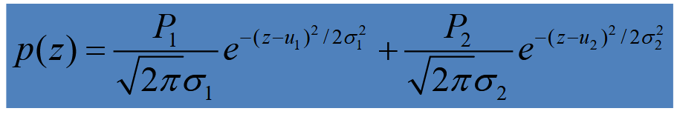
Optimal Global and Adaptive Thresholding
Computation of Analytical Expression for T
– obtaining the analytical expression for T requires that we know the equations for the two PDFs
Assume them to follow the most usual Gaussian density
Then expression for p(z) can be given as:

Slide 48
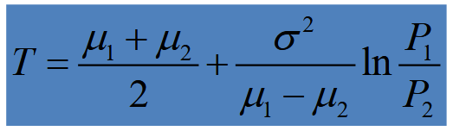
Optimal Global and Adaptive Thresholding
Under this conditions, if the two variances are equal
– an optimum threshold using the above procedures is:
If P₁ = P₂, the optimal threshold is the average of the means of two distributions.
The same is true if σ = 0

Slide 50
Image Segmentation
Part - 3
Region Growing, Region Split and Merge,
and Watershed Algorithm

Slide 51
Agenda
Quick Recap
Segmentation Basics
Similarity based segmentation
Thresholding
Region-based
Region growing
Region Split and merge
Watershed Algorithm
Discontinuity-based:
Use of point, line and edge for segmentation

Slide 52
Segmentation Basics
Image segmentation deals with image partitioning
– process of partitioning a digital image into multiple homogeneous segments
Segmentation Example
Simplification of representation
– Simplification of the representation of an image into something which is more meaningful and easier to analyze
Yellow lines show the segmentation boundary

Slide 53
Thresholding based Segmentation
Global Thresholding:
When same threshold is applied over entire image, the thresholding is referred as Global Thresholding
Adaptive thresholding
threshold is related to the location of the pixel
Optimal global and adaptive thresholding
Optimal criterion: minimum average segmentation error
Example:
An image where foreground objects (coins) can be segmented from black background using only one threshold

Slide 54
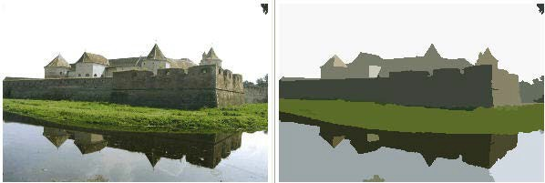
Region Based Segmentation
Region Based Segmentation Results

Slide 55

Region Based Segmentation
Basic formulation:
Let R represent the entire image region
Segmentation may be viewed as a process that partitions R into sub-regions, R₁, R₂, …, R_{n}, such that:
n
(a) ∪ R_{i} = R
Completeness: every pixel must be in a region
i =1
(b)R_{i} is a connected region ^{Connectedness}
(c)R_{i} ∩ R_{j}
_{= ∅, for any i ≠ j;} Disjointness: regions must be disjoint
(d )P(R ) = TRUE
Satisfiability: pixels of a region must satisfy
i
a common property
(e)P(R_{i} ∪ R_{j} ) = FALSE for any adjacent regions
Segmentability: Different regions satisfy different property
where P(.) is a logical predicate which deals with the properties that must be satisfied by the pixel in a segmented region.

Slide 56
Region Based Segmentation
Main Techniques
Region Growing
Unseeded Region Growing
Region Splitting and Merging
Segmentation by morphological Watersheds
Fast Scanning

Slide 57
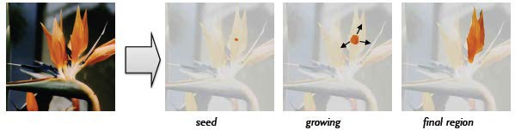
Region Growing
Region growing is a procedure that groups pixel or sub- regions into larger regions based on a predefined criteria from a set of “seed” points
Several key factors:
– the selection of “seed” points,
similarity criteria:
gray-level difference, gray-level variance, Color, texture
spatial proximity: adjacency definition
stopping rule

Slide 58
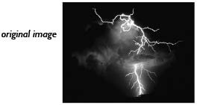
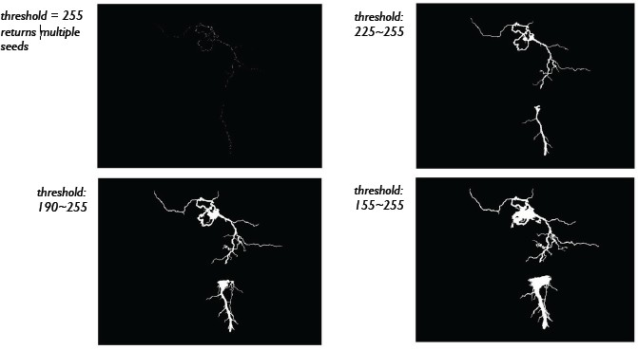
Region Growing: Example – 1
Problem: To isolate the strongest lightning region of the image on the right-hand side without splitting it apart
Solution:
🡪 Use region growing technique for segmentation
🡪 Seed points: choose the points having the highest gray-scale value which is 255 as the seed points
Segmentation outputs for selection of different threshold ranges to include neighbouring points

Slide 59
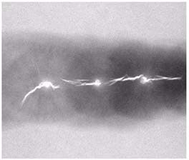
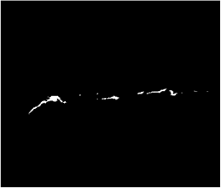
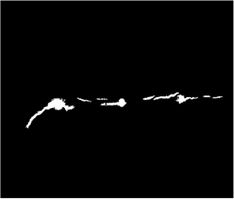
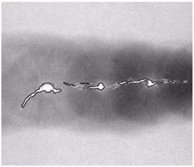
Example – 2: Detection of weld failure
Image showing defective welds
Seed Points
Result of region growing
Boundaries of segmented defective welds (in black)
(a)
(b)
(c)
(d)

Slide 60
Region Growing – Steps
Region growing: Groups pixels or sub-region into larger regions.
Step1:
Start with a set of “seed” points and from these grow regions by appending to each seed those neighboring pixels that have properties similar to the seed
Step2:
Region merging

Slide 61
Region Growing
Advantage:
Provides results with good connectivity
Disadvantage:
Initial seed-points selection:
different sets of initial seed-point cause different segmented result
Time-consuming process

Slide 62
Unseeded Region Growing
Unseeded region growing:
no explicit seed selection is necessary
the seeds can be generated automatically by the segmentation procedure
it is similar to Seeded Region Growing except the choice of seed point

Slide 63
Unseeded Region Growing
Advantage:
easy to use
can readily incorporate high level knowledge of the image composition through region threshold
Disadvantage:
slow speed

Slide 64
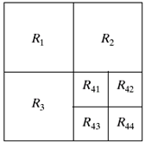
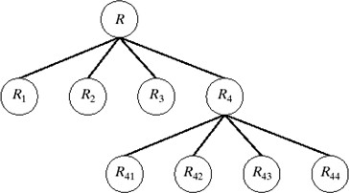
Region Splitting and Merging
Step 1: This approach is to subdivide an image initially into a set of arbitrary, disjointed regions (quadrants)
Step 2: Merge and/or split the regions in an attempt to satisfy the conditions (a)~(e) mentioned in the starting of this section.
Splitting Process:
Partitioned Image
Corresponding quad-tree
Merging Process:
– After finishing the splitting, for any two adjacent regions R_{i} and R_{j}, if P(Ri∪Rj)=True, the two regions must be merged.

Slide 65

Region Splitting and Merging – Detailed Steps
At the beginning, split the initial image into quadrants
Split into four disjoint quadrants any region R_{i} for which P(R_{i})=FALSE
Merge any adjacent regions R_{i} and R_{j} for which P(R_{i} ∪ R_{j}) = True
Stop until no further merging or splitting is possible
Example:
Original image
Result of split & merge procedure
Result of thresholding (a)
(a)
(b)
(c)

Slide 66
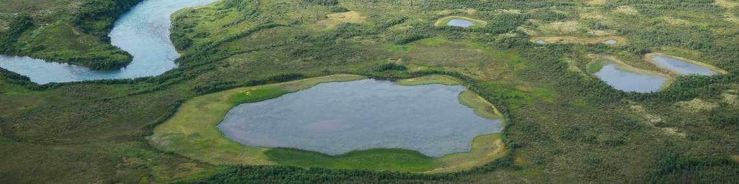
Watershed Segmentation
What is Watershed?
– A watershed is the area of land that drains to a particular point along a stream
Image source: https://www.neefusa.org/nature/water/lesson-1-watershed-basics

Slide 67
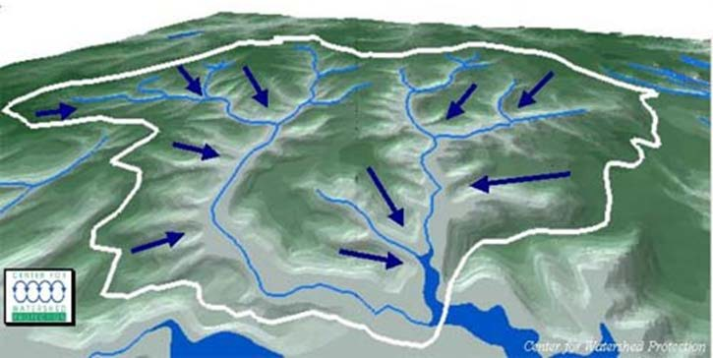
Watershed Segmentation
What is Watershed? ….continued
– A watershed is the area of land that drains to a particular point along a stream
Image source: https://springfieldohio.gov/we-all-live-in-a-watershed/

Slide 68
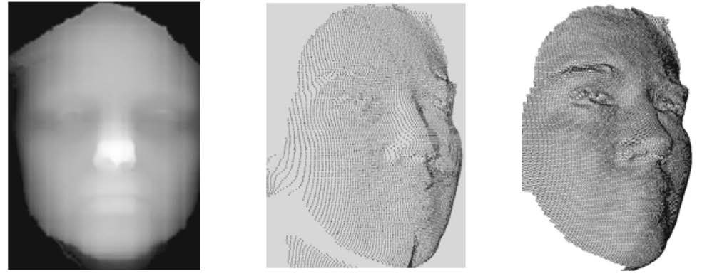
Watershed Segmentation
Visualize an image in 3D topographic view: spatial coordinates and gray levels
(a) 2D image representation (b) Point cloud (3D) (c) 3-D mesh (for example, gray)
3-D Face Representations (3D topographic view)
Image source: 3-D face recognition: Features, databases, algorithms and challenges, Artificial Intelligence Review, 44(3):393-441, October 2015, DOI: 10.1007/s10462-015-9431-0

Slide 69

Watershed Segmentation
Visualize an image in 3D topographic view: spatial coordinates and gray levels ….continued

Slide 70
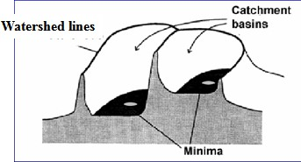
Watershed Segmentation
In a 3D topographic interpretation of the image, there are 3 types of points
Point belonging to a regional minimum
Catchment basin or watershed: Points at which a drop of water, if placed at the location of any these points, would fall with certainty to a single minimum
Divide lines or watershed lines: points at which it would be equally likely for a drop of water to fall to more than one such minimum

Slide 71
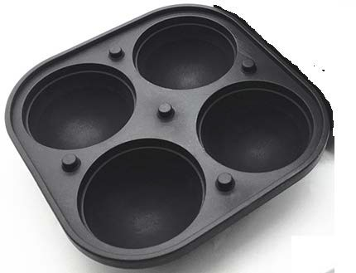
Watershed Segmentation
The objective is to find watershed lines
The idea is simple:
Suppose that a hole is punched in each regional minimum and that the entire topography is flooded from below by letting water rise through the holes at a uniform rate
When rising water in distinct catchment basins is about the merge, a dam is built to prevent merging
These dam boundaries correspond to the watershed lines

Slide 72
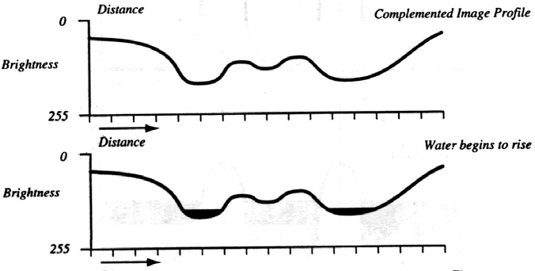
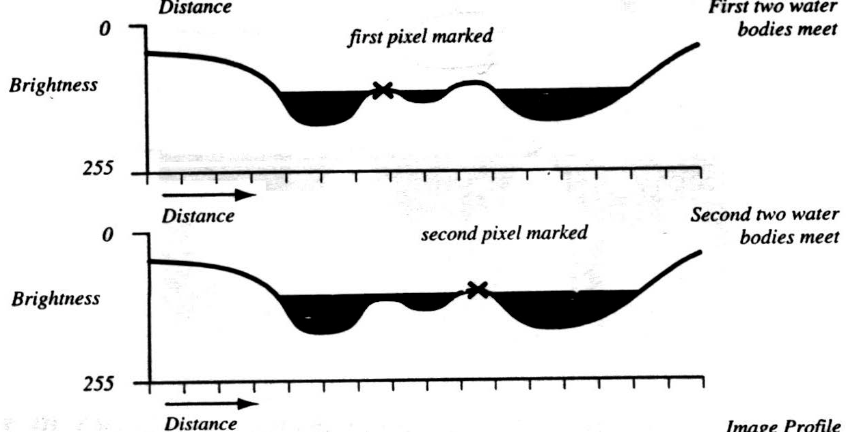

Watershed Segmentation

Slide 73
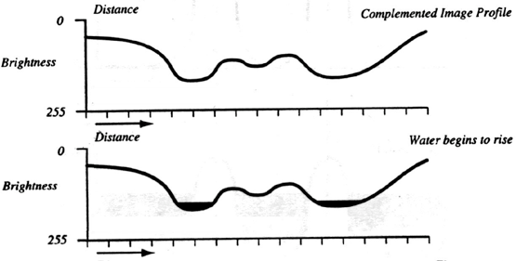
Watershed Segmentation – Steps
Algorithm:
Start with all pixels with the lowest possible value
These form the basis for initial watersheds
For each intensity level k:
For each pixel of intensity k
If adjacent to exactly one existing region, add these pixels to that region
Else if adjacent to more than one existing regions, mark as boundary
Else start a new region
– Implemented with breadth-first search

Slide 74
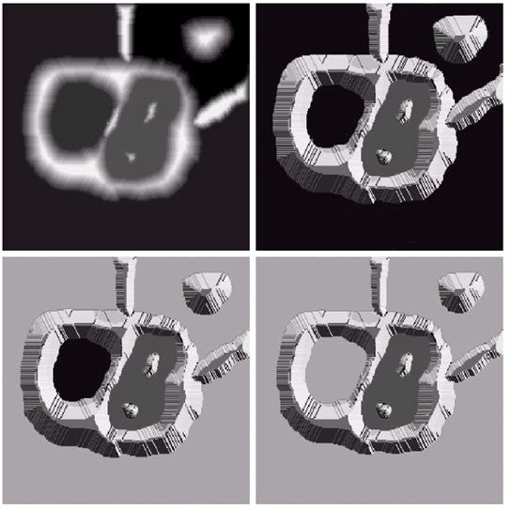
Figure Illustration of Watersheds Algorithms
Topographic View
Original Image
Next stage of flooding where water has leaked from hole
Start of flooding where only the darkest portions are flooded
Initial flooded area (the darkest portions)
Water started leaking through hole

Slide 75
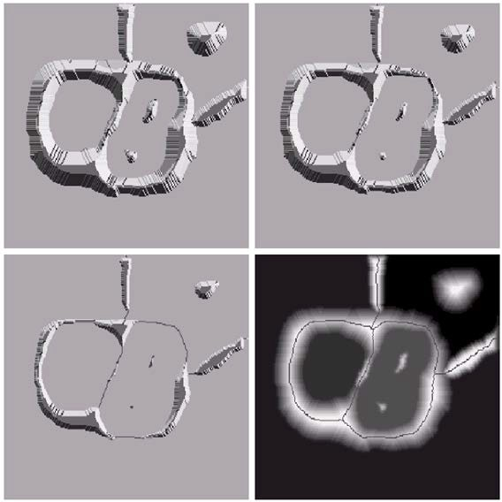
Figure Illustration of Watersheds Algorithms
Beginning of merging of water from two catchment basins (a short dam was built between them)
Result of further flooding
Final watershed (segmentation ) lines
Longer dams

Slide 76
Important Note
In practice, Watershed Segmentation approach is usually applied to the gradient of an image, rather than on the image itself.

Slide 77
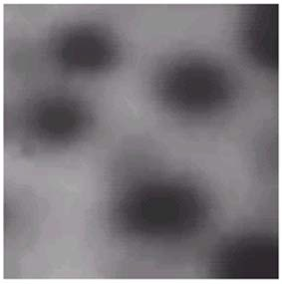
Applications of Watershed Segmentation
One of the principal applications of watershed segmentation is in the extraction of nearly uniform (blob like) objects from the background

Slide 78
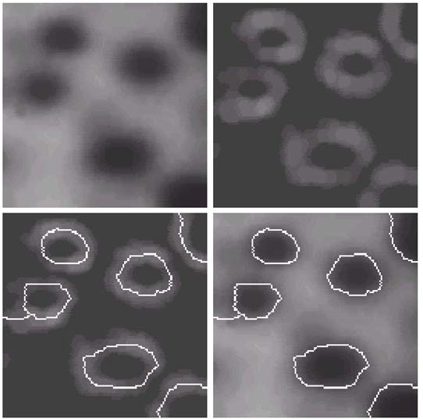
Example
Image gradient
Image of blobs
Watershed lines superimposed on original image
Watershed lines

Slide 79
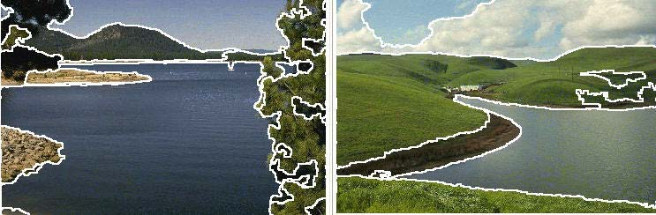
Edge Based Segmentation
Compute edges
Perform edge linking to get close boundary
Edge Based Segmentation Results

Slide 80
Comparison with Region based Techniques
Region based techniques are better than edge based techniques for noisy images where edge detection is a problem

Slide 82
MORE ON WATERSHED SEGMENTATION

Slide 83
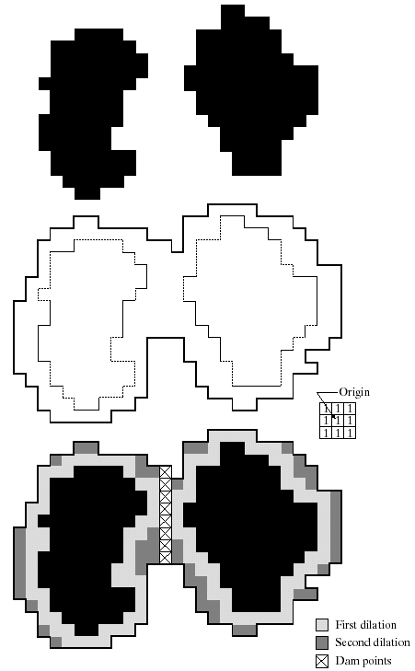
Process of Dam Construction
(a)
(b)
Two partially flooded catchment basins at stage n-1 of flooding
Flooding at stage n, showing that water has spilled between basins (for clarity, water is shown in white rather than black)
Structuring element used for dilation
Result of dilation and dam construction
(c)
(d)

Slide 84
Dam Construction
Dam construction is based on binary images
The simplest method to make dam in binary images is to use morphological dilation
Figure (a) [in previous figure] shows the points in the catchment basins associated with these two minima at stage n-1
Let each connected component (of Figure (a)) is dilated by the structuring element shown in Figure (c)
– Let union of original components shown in Figure (a) denoted as C [n-1]
After dilation we get one connected components shown in Figure (b) which encompasses the original components

Slide 85
Dam Construction
Note that all points belonging to an individual catchment basin form single connected component
The fact that two connected components have become a single component indicates that water between the two catchment basins has merged at flooding step n
– Let this connected component be denoted q.
Note that the two components from step n-1 can be extracted from q by performing the simple AND operation q ∩ C [n-1]

Slide 86
Dam Construction
Two conditions must be satisfied in process of dilation of components in Figure (a) to construct dam
First, the dilation has to be constrained to q (denotes the connected component in Figure (b) )
This means that the center of the structuring element can be located only at points in q during dilation
Second, the dilation can’t be performed on points that would cause the sets being dilated to merge (become a single connected component)

Slide 87
Dam Construction
First Dilation Pass
Figure (d) shows that the first dilation pass (in light gray) expanded the boundary of each original connected component
Note that condition (1) was satisfied by every point during dilation
Condition (2) did not apply to any point during the dilation process; thus the boundary of each region was expanded uniformly

Slide 88
Dam Construction
Second Dilation Pass
In the second dilation (shown in black), several points failed condition
(1) while meeting condition (2), resulting in the broken perimeter shown in Figure (d)
It is also evident that the only points in q that satisfy the two conditions under consideration describe the 1-pixel-thick connected path shown crossed-hatched in Figure (d)
This path constitutes the desired separating dam at stage n of flooding

Slide 89
Dam Construction
Construction of the dam at this level of flooding is completed by setting all the points in the path just determined to a value greater than the maximum intensity value of the image
The height of all dams is generally set at 1 plus the maximum allowed value in the image
This will prevent water from crossing over the part of the completed dam as the level of flooding is increased

Slide 90
The Use of Markers
Over Segmentation Problem of Watershed Algo:
Direct application of the watershed segmentation algorithm generally leads to over-segmentation due to noise and other local irregularities of the gradient
Solution: Use of preprocessing
A practical solution to this problem is to limit the number of allowable regions by incorporating a preprocessing stage
This is to bring additional knowledge into the segmentation procedure

Slide 91
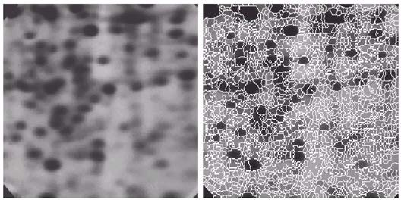
Example: Over-segmentation Phenomenon
Electrophoresis image
Result of applying the watershed segmentation algorithm to the gradient image (Over segmentation is evident)

Slide 92
The Use of Markers
Concept of Marker:
An approach used to control over-segmentation is based on the concept of markers
What is a marker?
A marker is a connected component belonging to an image, including internal marker (associated with objects of interest) and external marker (associated with background)
Two principal steps for marker selection:
Preprocessing
Set of criteria that markers must satisfy

Slide 93
The Use of Markers
Note: Usually over segmentation happens due to existence of large number of potential minima
Effective way to handle this is by use of low pass (smoothing) filter
This is an appropriate preprocessing scheme in this case

Slide 94
Example of Controlling Over-Segmentation Phenomenon
Internal markers are defined as:
a region that is surrounded by points of higher “altitude”
points in the region form a connected component such that all points in the connected component have the same gray-level value

Slide 95
Example of Controlling Over-Segmentation Phenomenon
Steps:
First the image was smoothed, then internal markers were formed shown as light gray blob like region (using the definition of marker given in previous slide)
Next, the watershed algorithm was applied under the restriction that these internal markers be the only allowed regional minima

Slide 96
Example of Controlling Over-Segmentation Phenomenon
Steps (…contd):
The resulting watershed lines are defined as the external markers
This effectively partition the image into regions, with each region containing a single internal marker and part of background

Slide 97
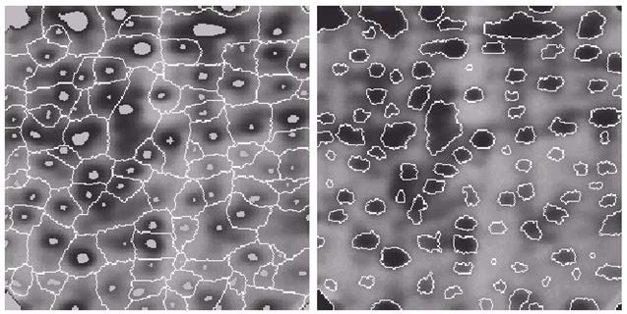
Segmentation using Internal Markers as Regional Minima
Image showing internal markers (light gray regions) and external markers
Result of segmentation. Note the improvement over result obtained earlier

Slide 98
Segmentation using Internal Markers as Regional Minima
Marker selection can range from simple procedures based on gray-level values and connectivity, to more complex descriptions involving
size
shape
location
relative distances
texture content, and so on
Use of marker brings a priori knowledge to bear on the segmentation problem

